Slide 1

Creating your own VR project

Slide 2

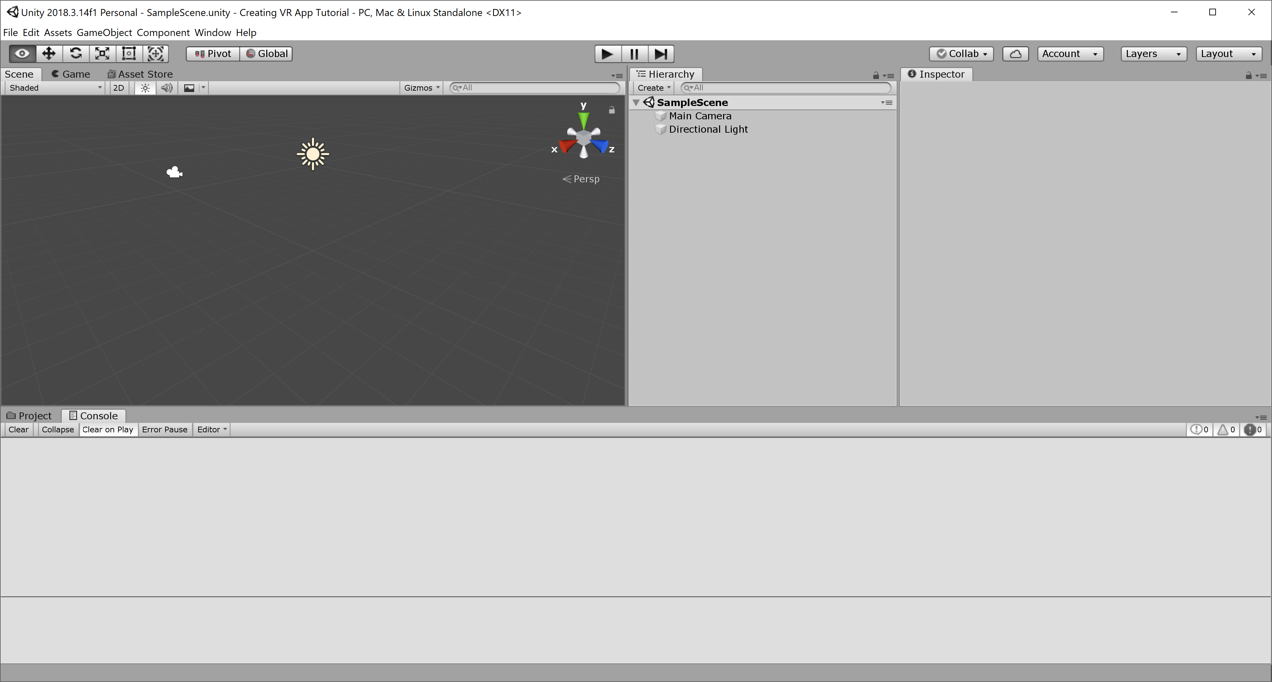
Getting started
Now that we know how to modify an existing Google VR project, let’s create one from the beginning
Create a new project in Unity

Slide 3
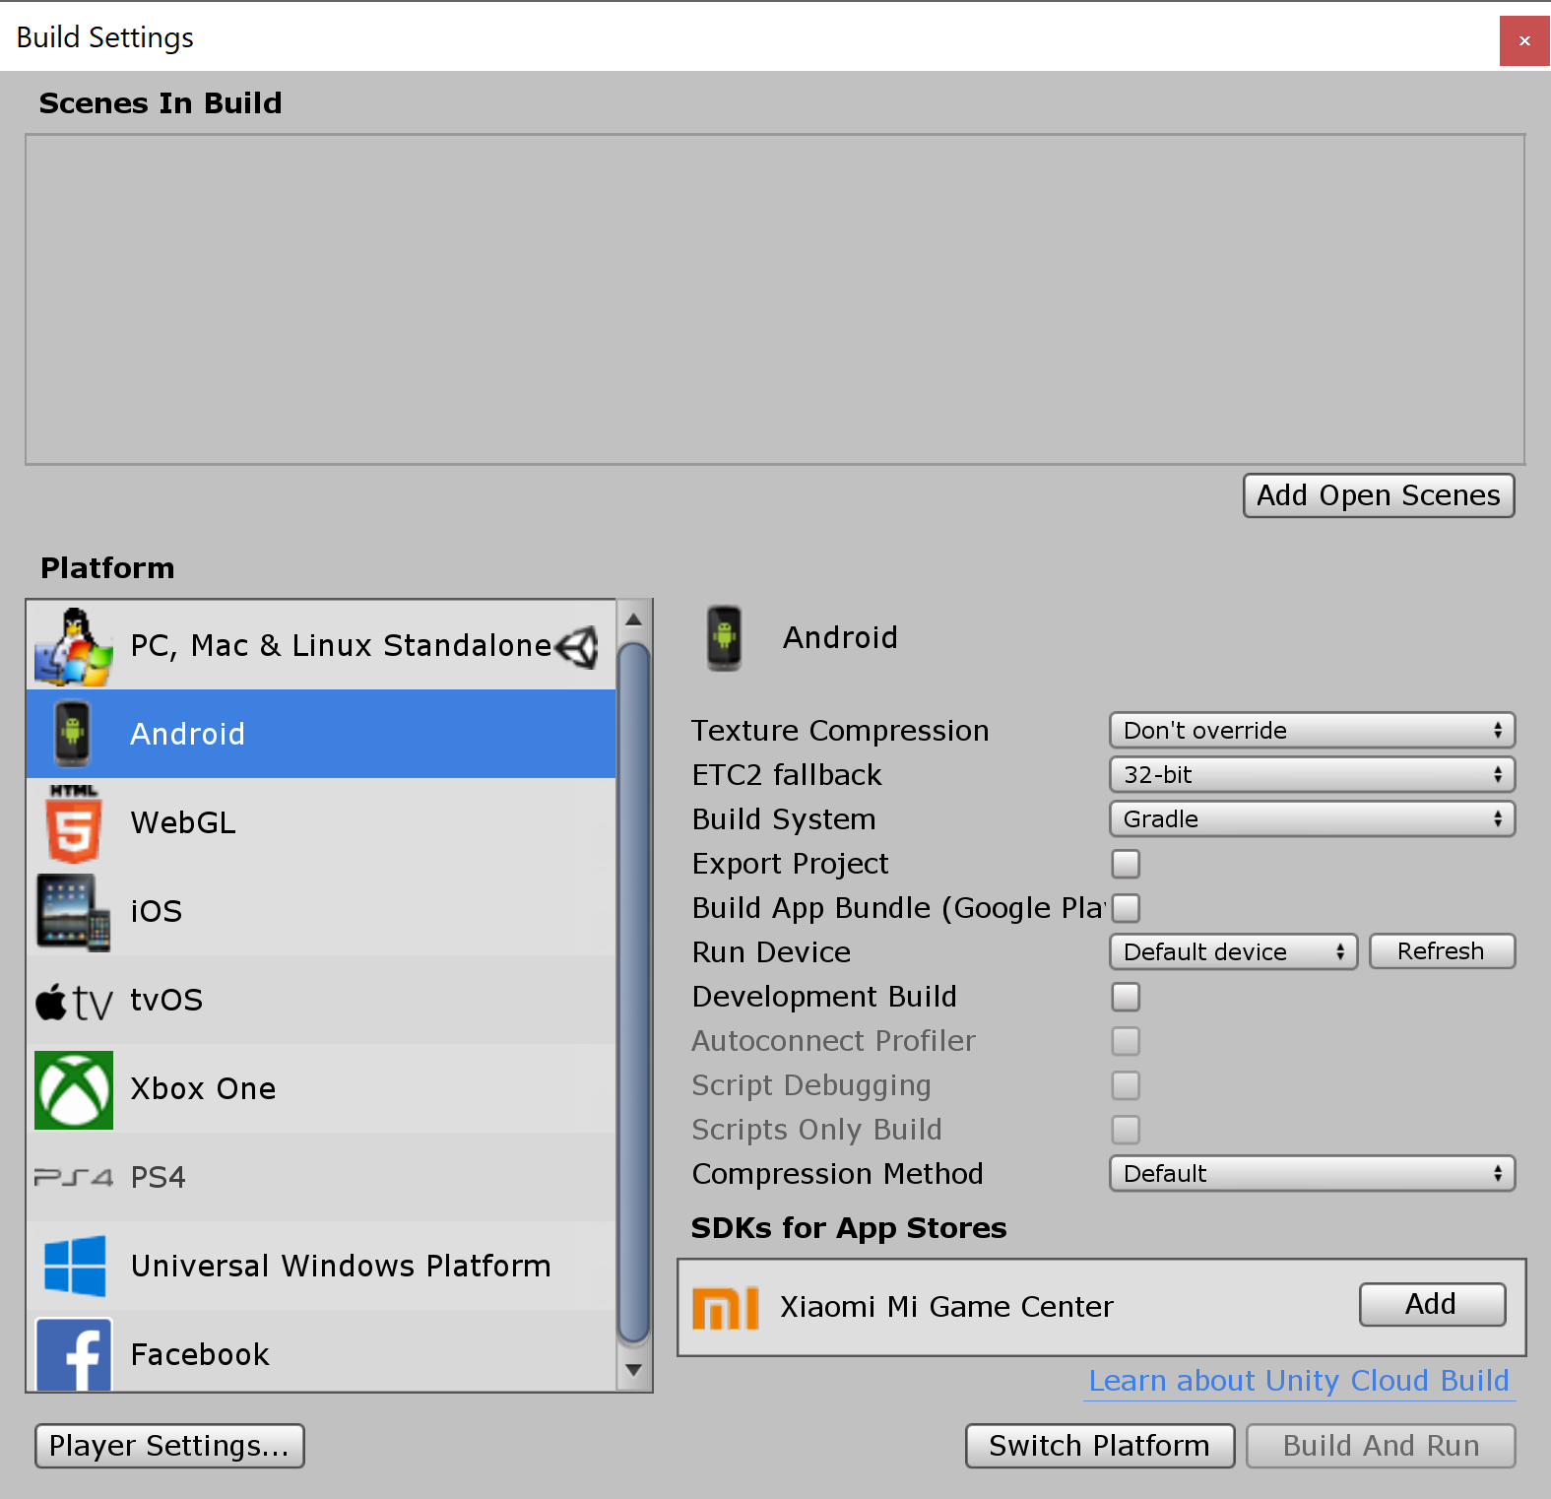
Getting started
Change the build settings to select your desired platform
Click “Switch Platform”

Slide 4
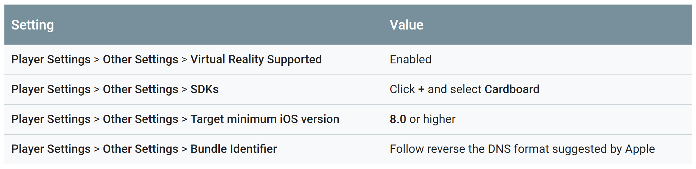
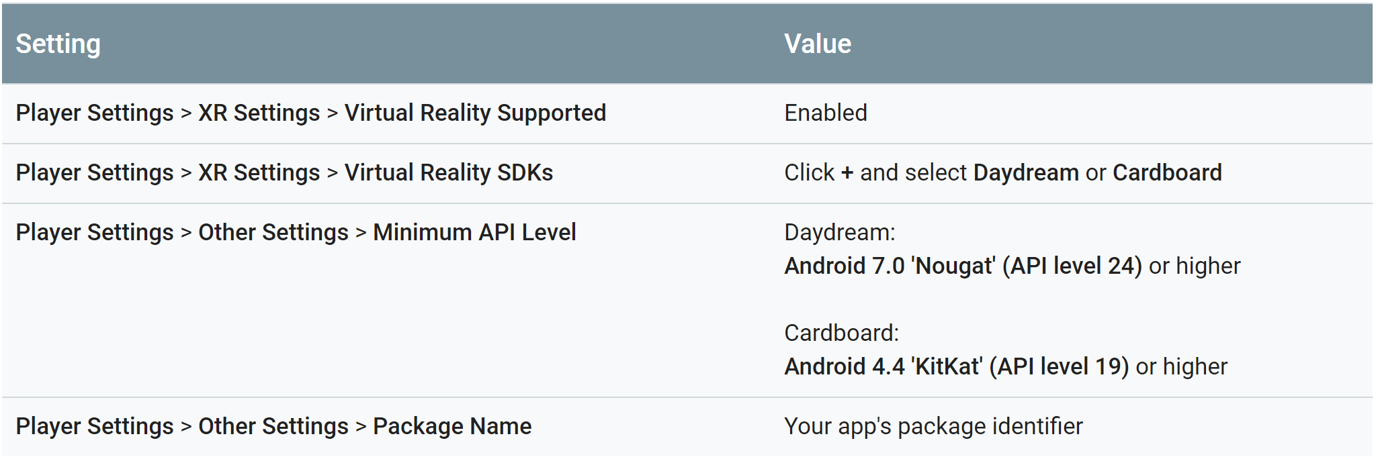
Getting started
Click on “Player Setting”
For iOS:
For Android:

Slide 5
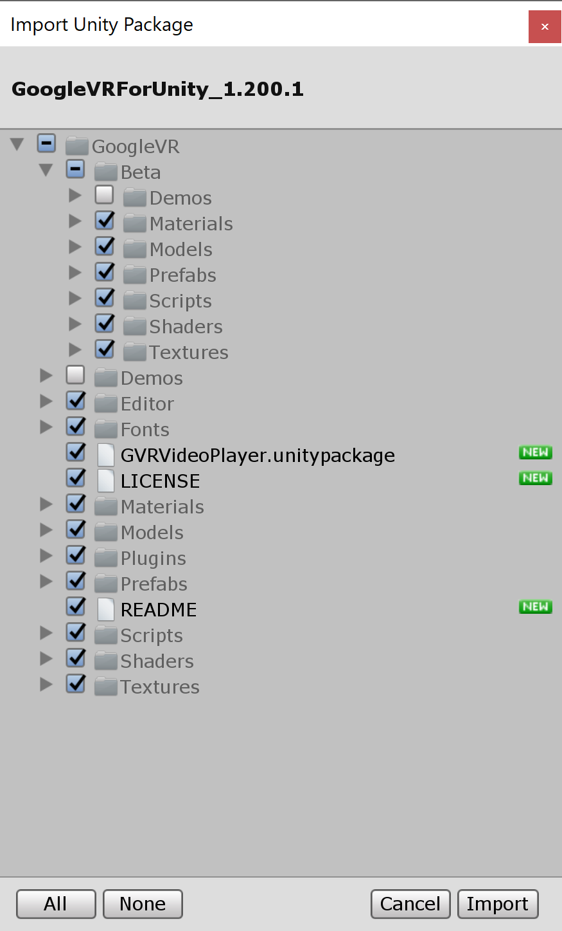
Getting started
Import the Google VR unity package
Unselect the files associated with the demo
This will import all the prefabs, scripts, etc. necessary to build your own VR app while excluding the files related to the demo

Slide 6
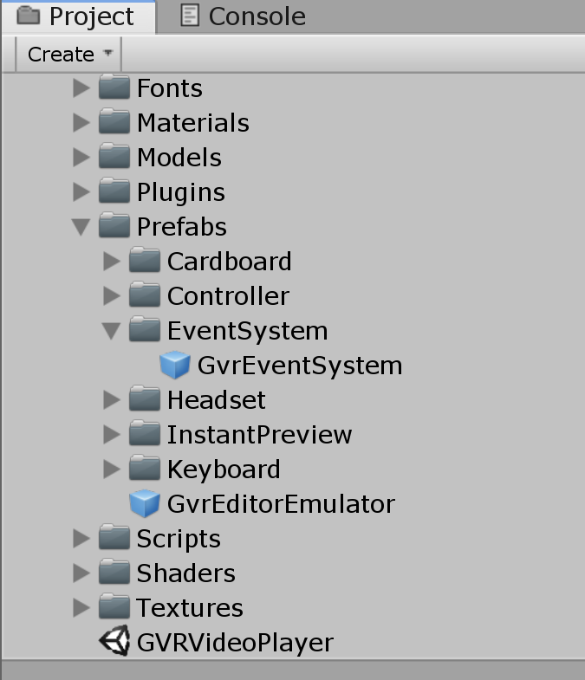
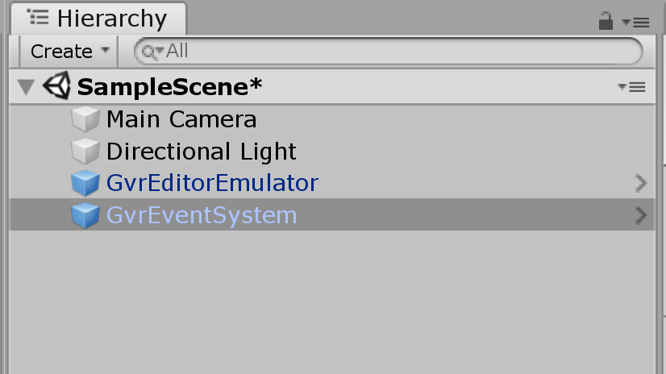
Add Google VR prefabs
Add the GvrEventSystem and the GvrEditorEmulator to your scene

Slide 7
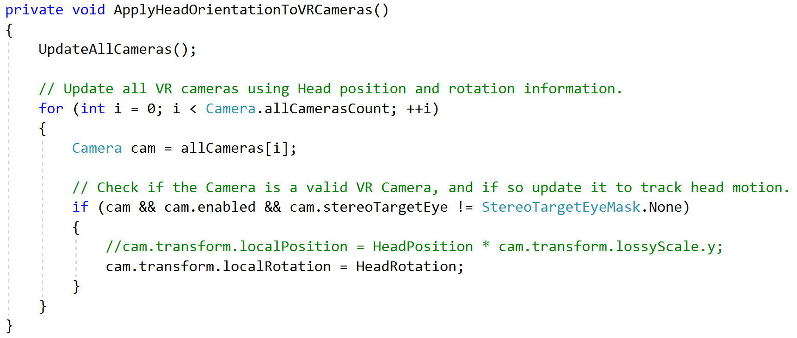
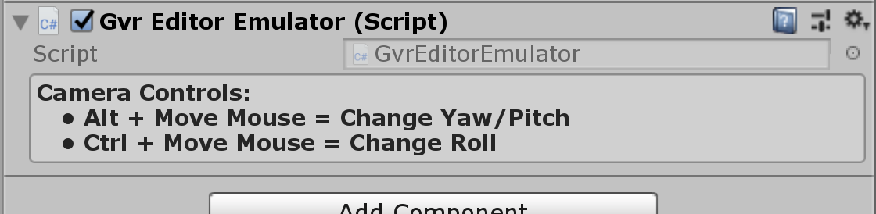
Preemptive issue fix
The GvrEditorEmulator has an issue where the camera automatically resets to the origin of the scene when running your application in the editor
To fix this issue, edit the GvrEditorEmulator script and comment out the following line in the function called “ApplyHeadOrientationToVRCameras”:
cam.transform.localPosition = HeadPosition * cam.transform.lossyScale.y;

Slide 8
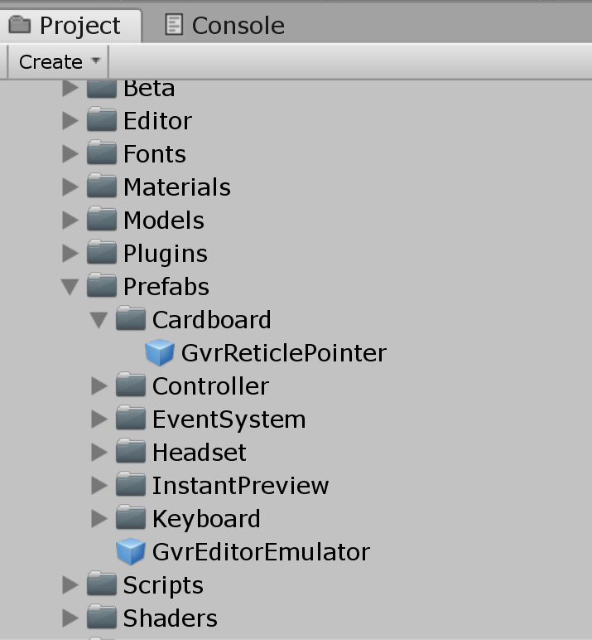
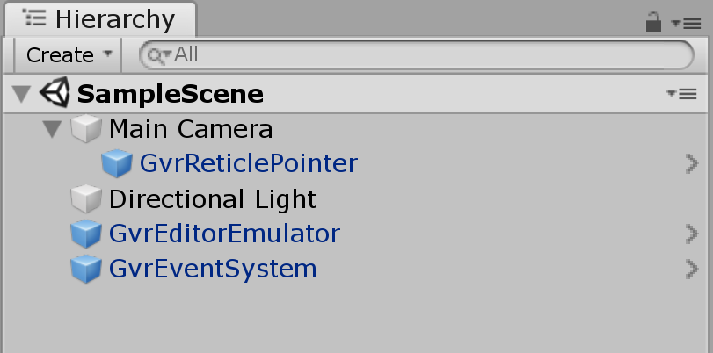
Setting up the camera
Add the GvrReticlePointer prefab as a child of your camera

Slide 9
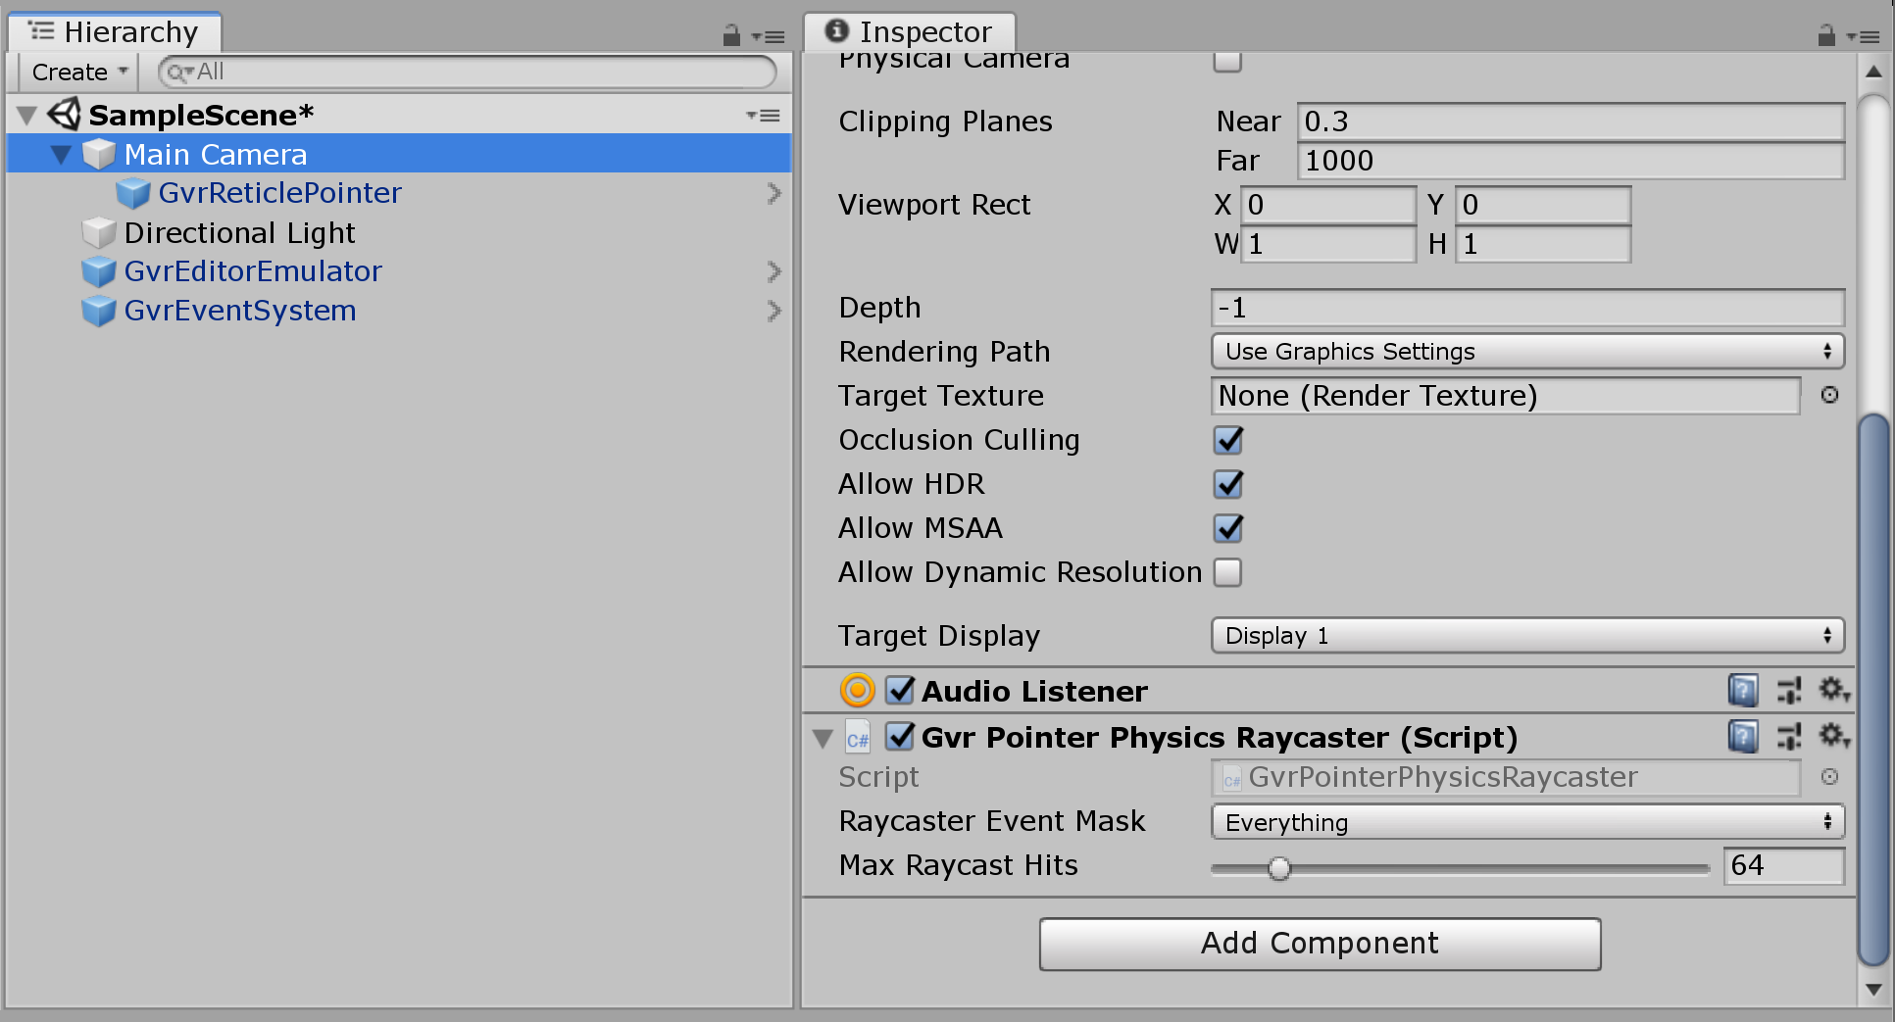
Setting up the camera
Add the GvrPointerPhysicsRaycaster component to your camera

Slide 10
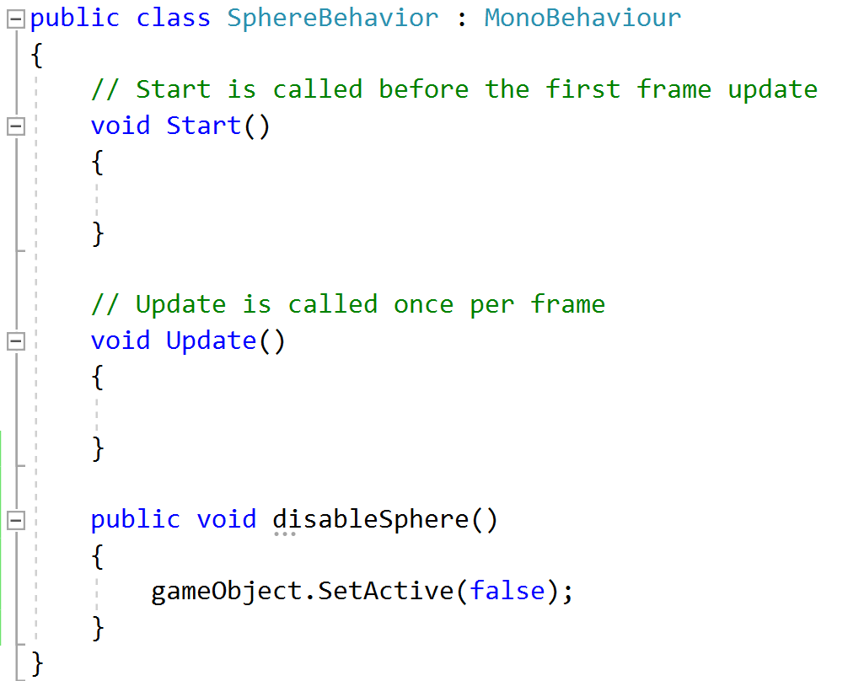
Creating an object
Add a sphere (or any other object) to your scene and place it in front of the camera
Add a script to your object and include a function for the desired behavior
For example, disabling the game object
Make sure the function is public

Slide 11
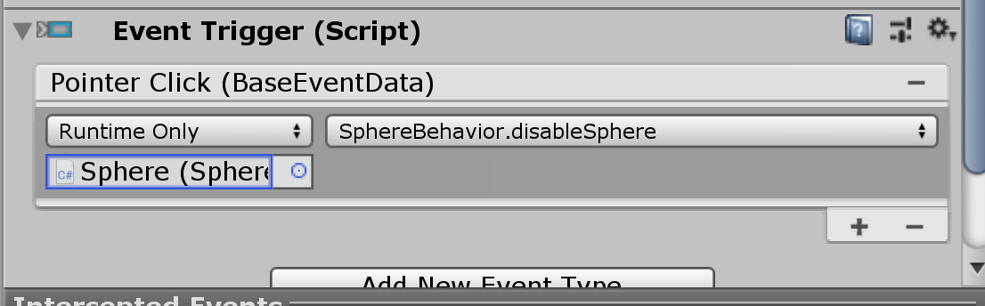
Handling input
Add an Event Trigger component to your object
Associate the function you created to one of the event trigger
For example “Pointer Click”

Slide 12
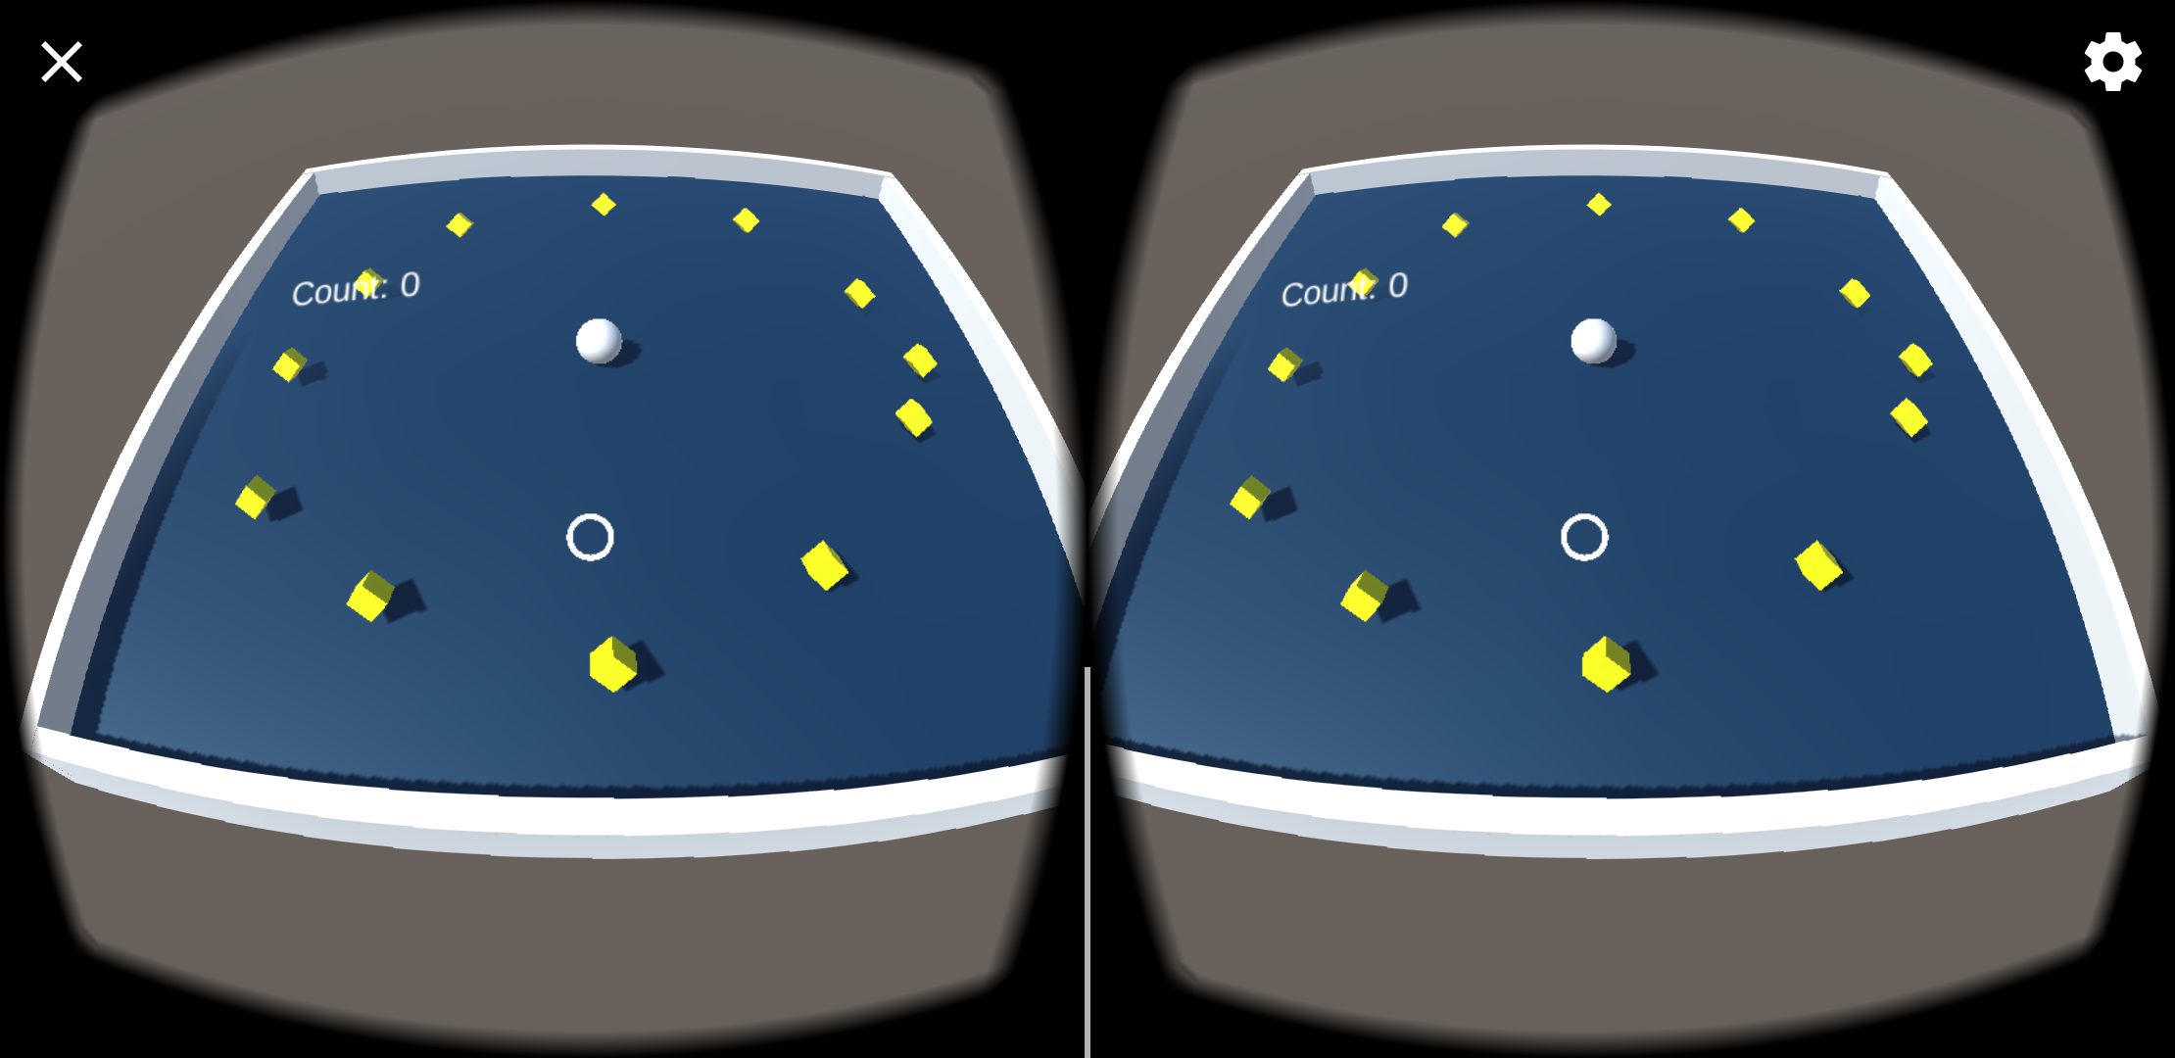
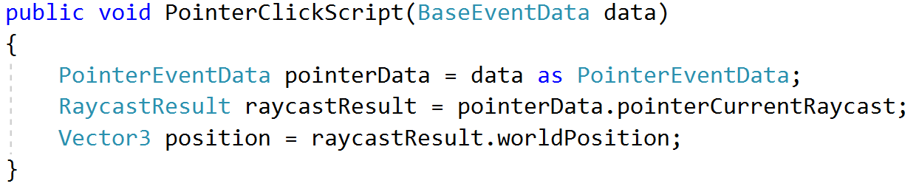
Creating your VR app
Work on a VR app of your design
Arrange objects in a scene that will be visualized in VR
Make the objects respond to inputs (e.g., pointer enter and exit, pointer click, etc.)
Create a VR version of your Roll-a-ball game
May be useful to know when handling user inputs:
Functions that are triggered by the “Pointer Click” event can receive data that provide the position where the user clicked:

Slide 13
Your VR app
Tell us about your VR application
What did you create?
Did you run into any challenges?
How did you solve them?

